Slide 1
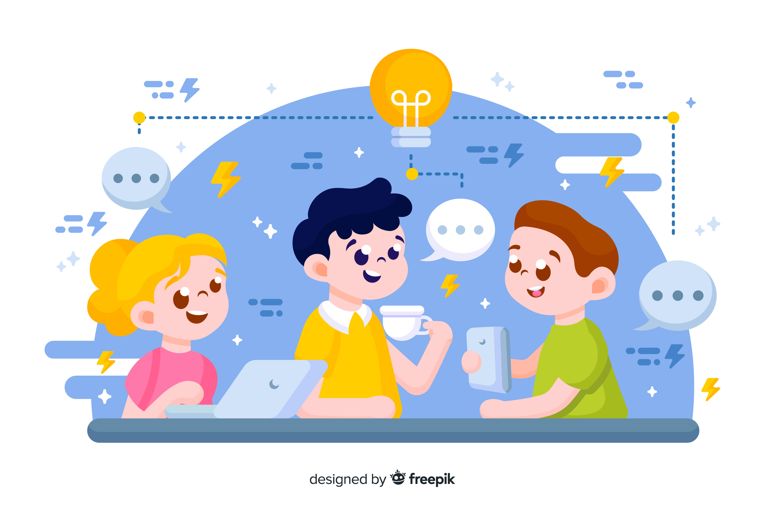
Learn Programming For Kids (Python)

Slide 2
Lesson 1
What is Programming?

Slide 3
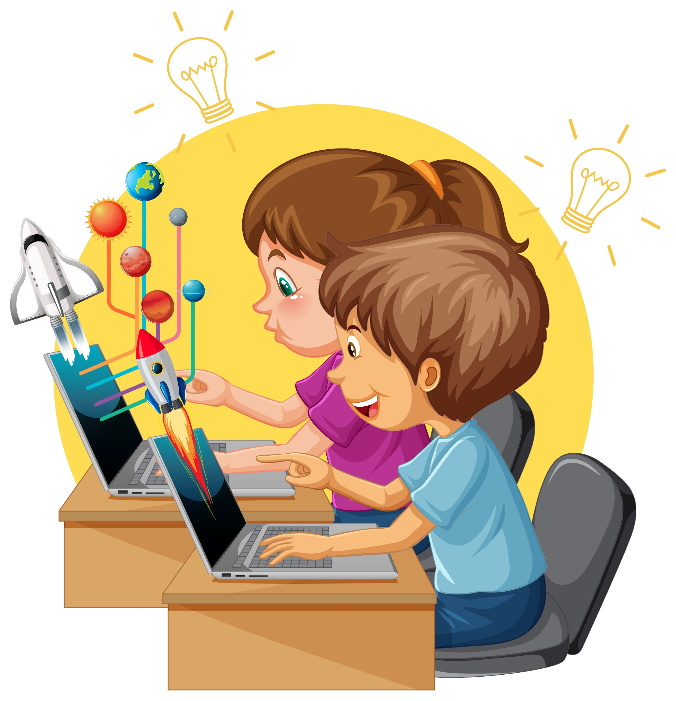
What is Programming?
Programming is like giving instructions to a computer to make it do cool things!

Slide 4
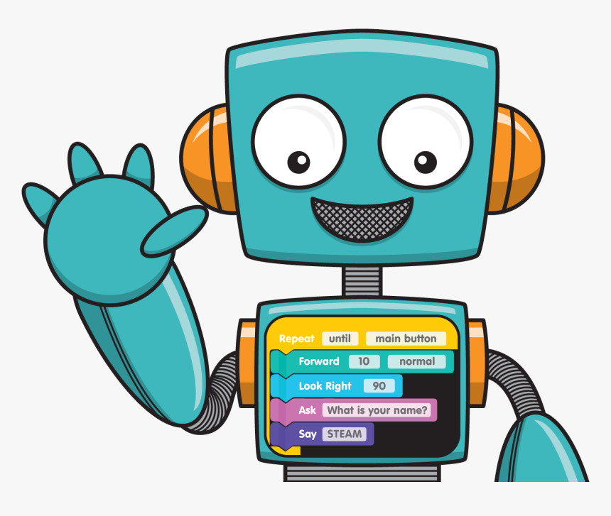
Imagine you have a robot friend, and you want it to dance or draw a picture. Programming is like telling the robot exactly what steps to follow so it can perform those actions. Instead of using words, you use a special language that the computer understands. It's like being a superhero and teaching your computer sidekick how to bring your ideas to life!

Slide 5
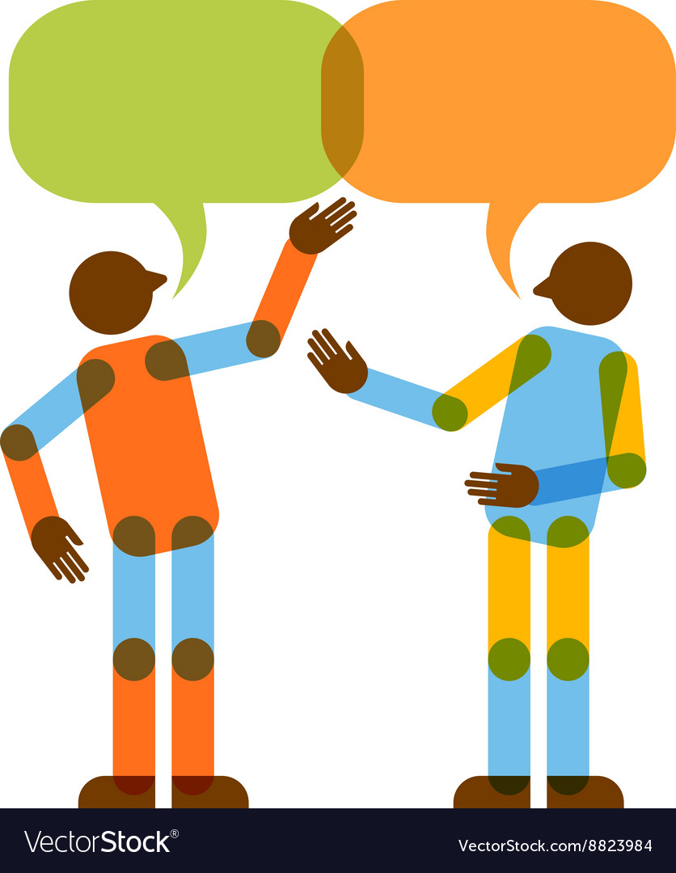
Programming Languages

Slide 6
What is Programming Languages?
Imagine you have a secret code that only you and your computer can understand. This secret code is like a special language that helps you tell the computer what you want it to do. We call this special language a "programming language."

Slide 7
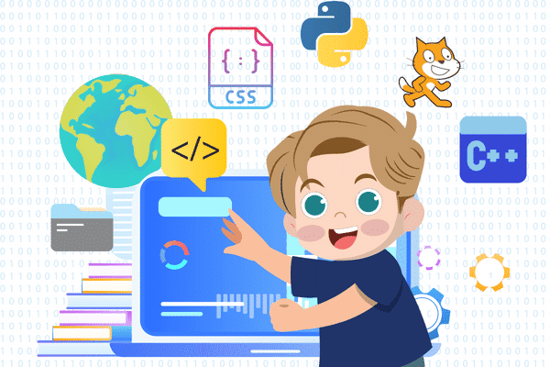
So, programming languages are like the magical words you use to make your computer buddy do awesome tricks and games!

Slide 8
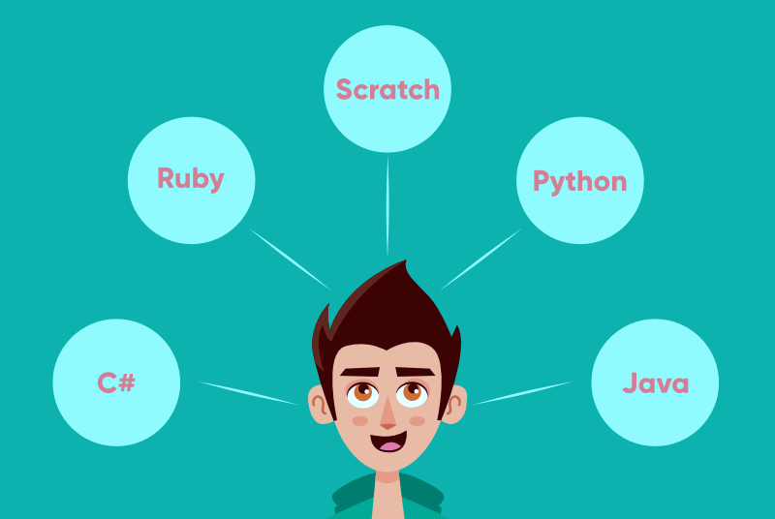
There are many programming languages such as:

Slide 9
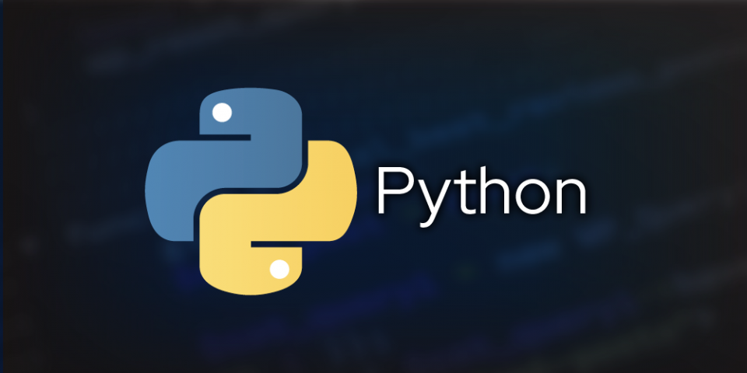
We will learn together

Slide 10
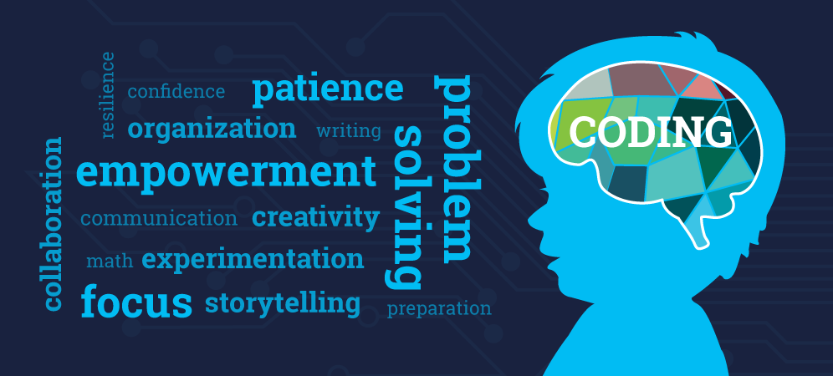
What is the importance of learning programming?

Slide 11
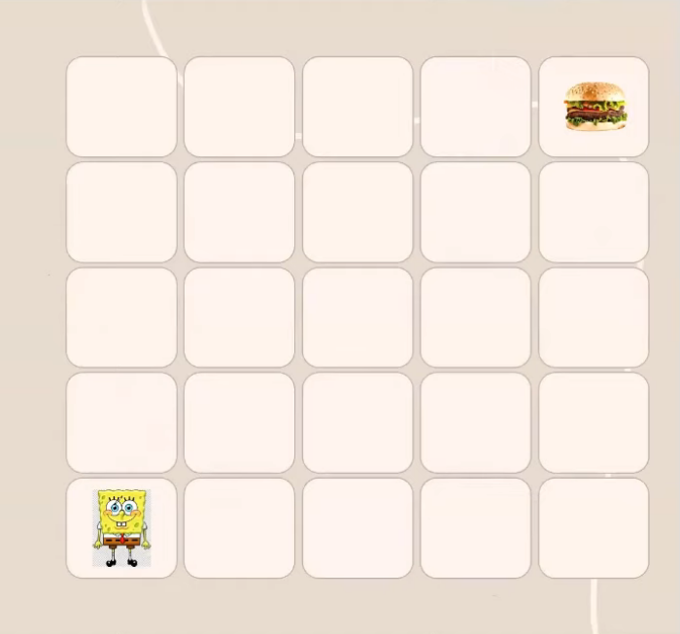
Programming Thinking

